Slide 1
物聯網實務 HW15
電機碩一 11278008 林佳慧
日期:2024/01/03

Slide 2
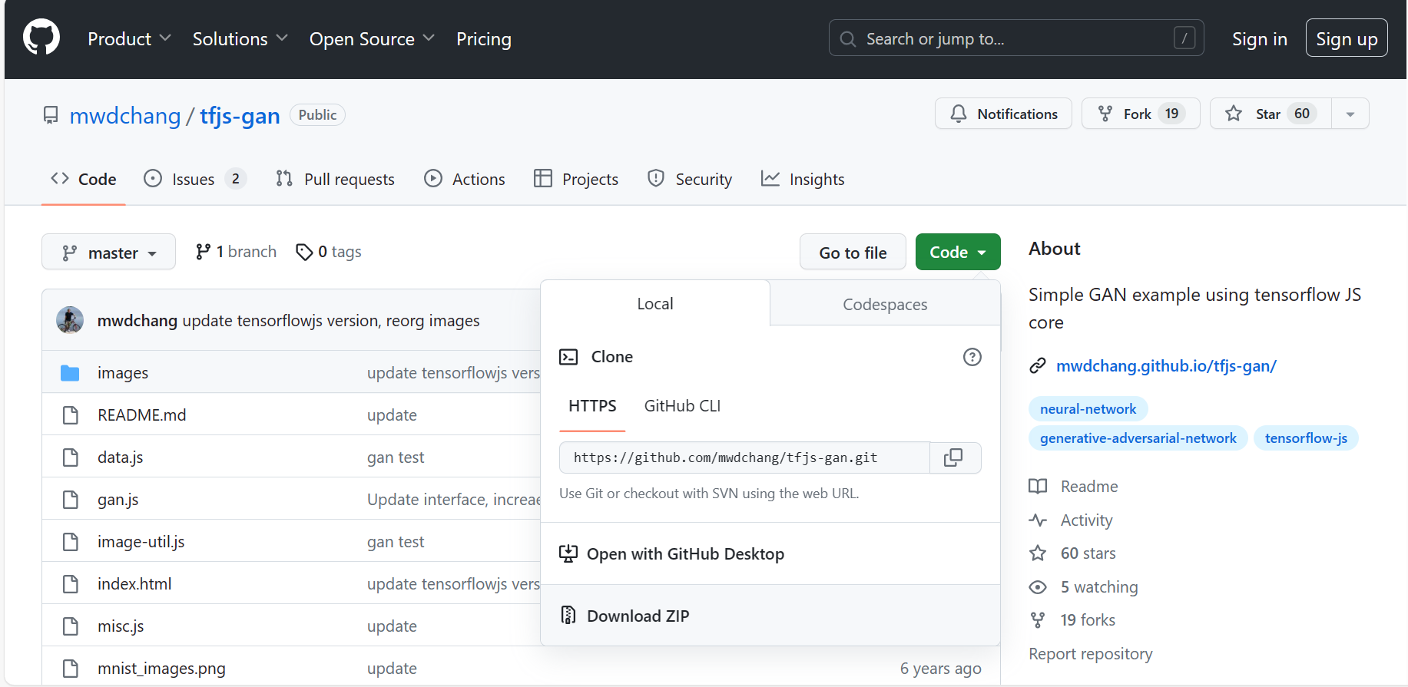

Slide 3
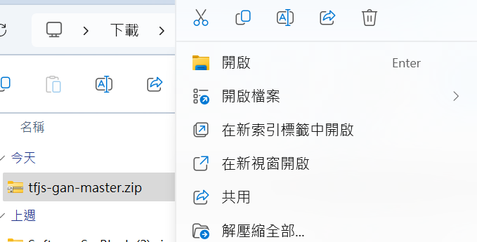

Slide 4
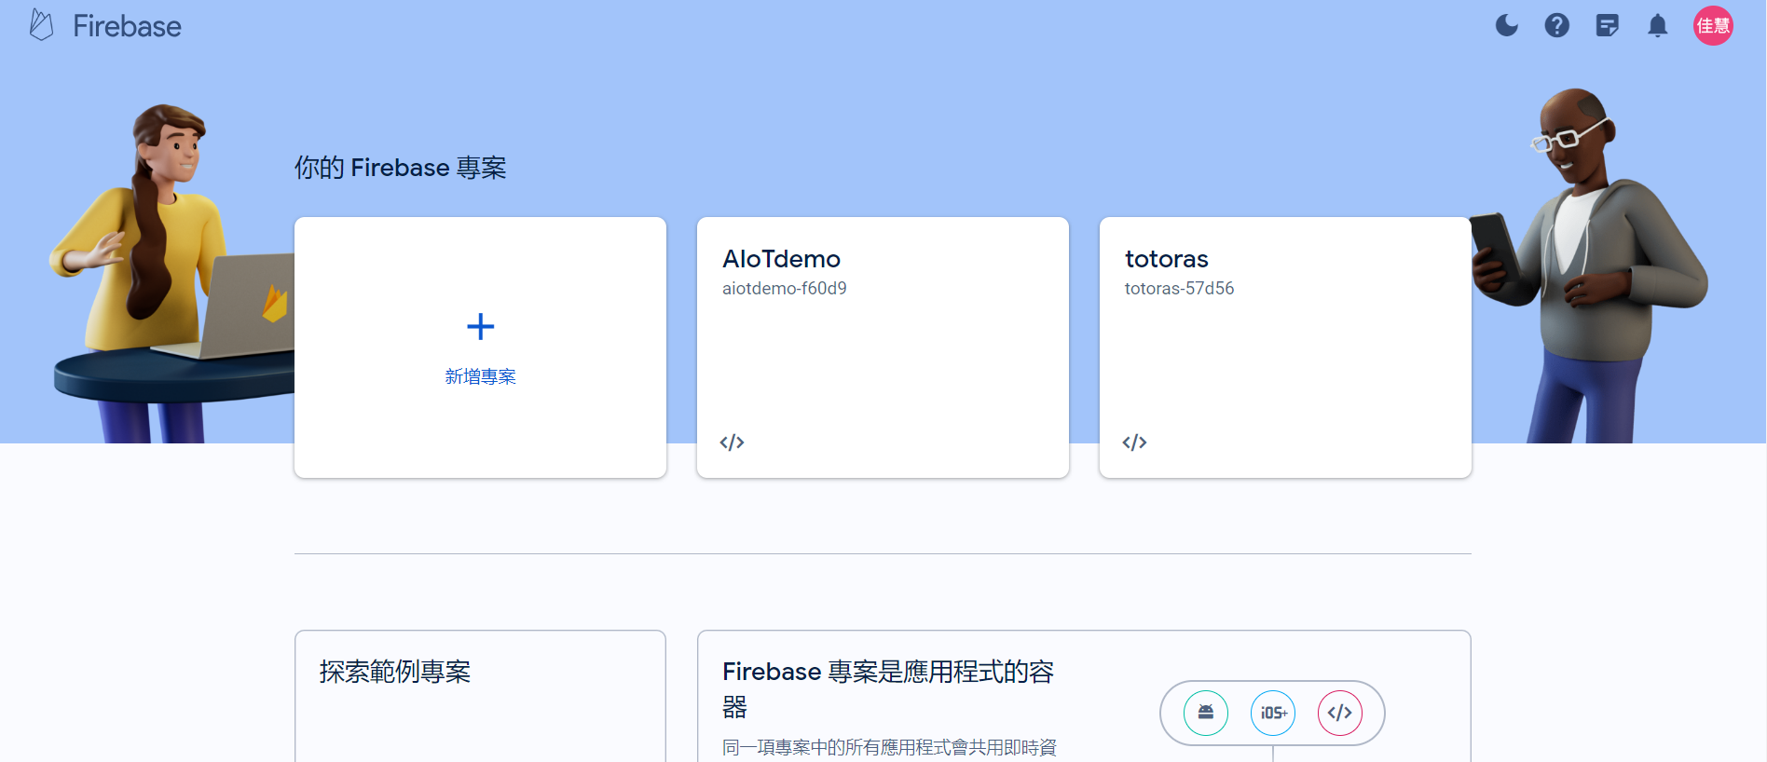

Slide 5
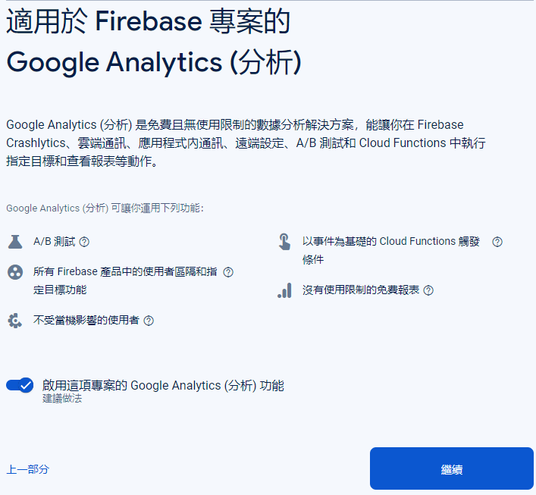
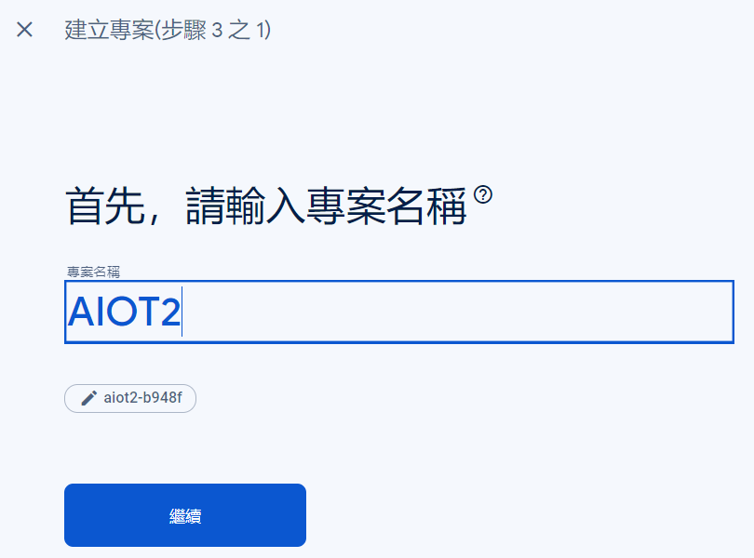
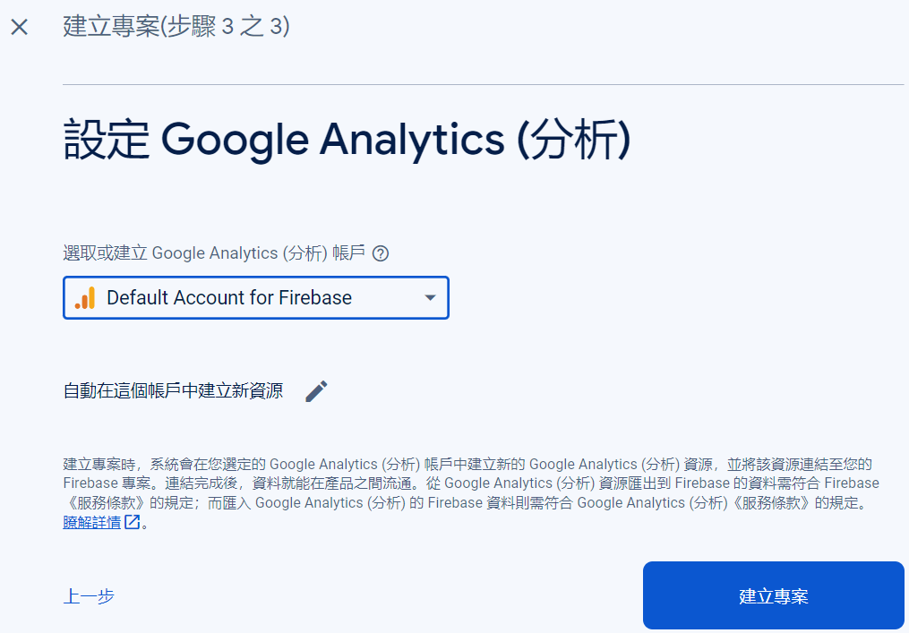
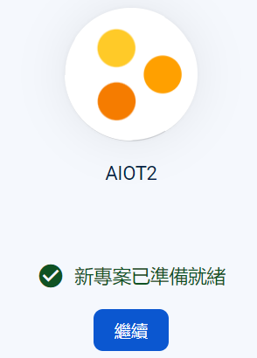

Slide 6
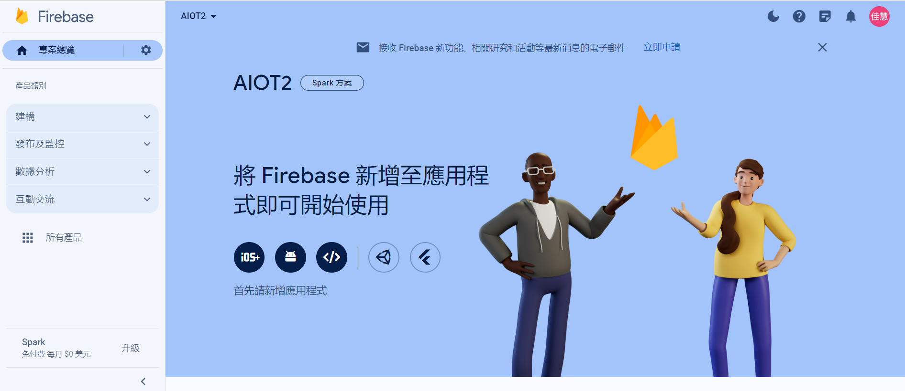

Slide 7
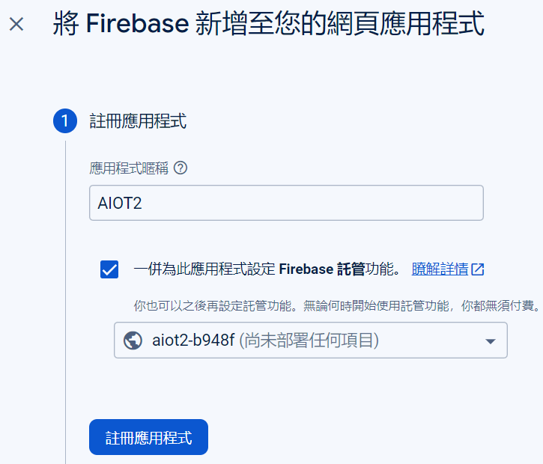
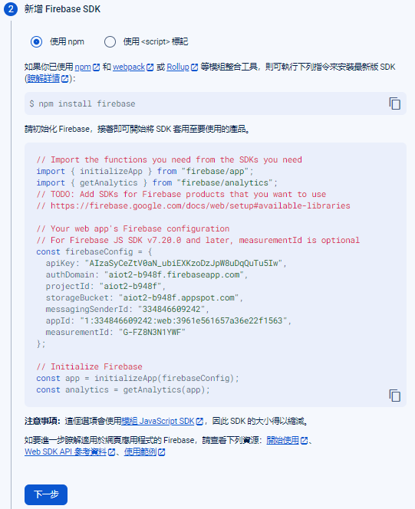
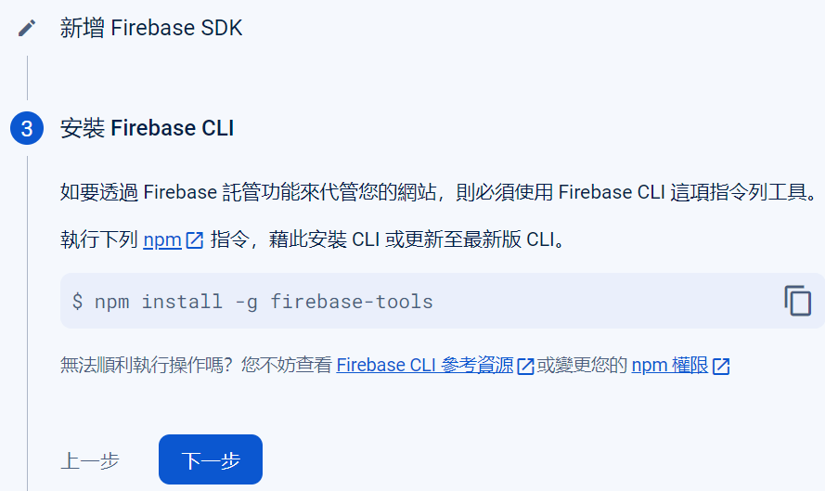

Slide 8
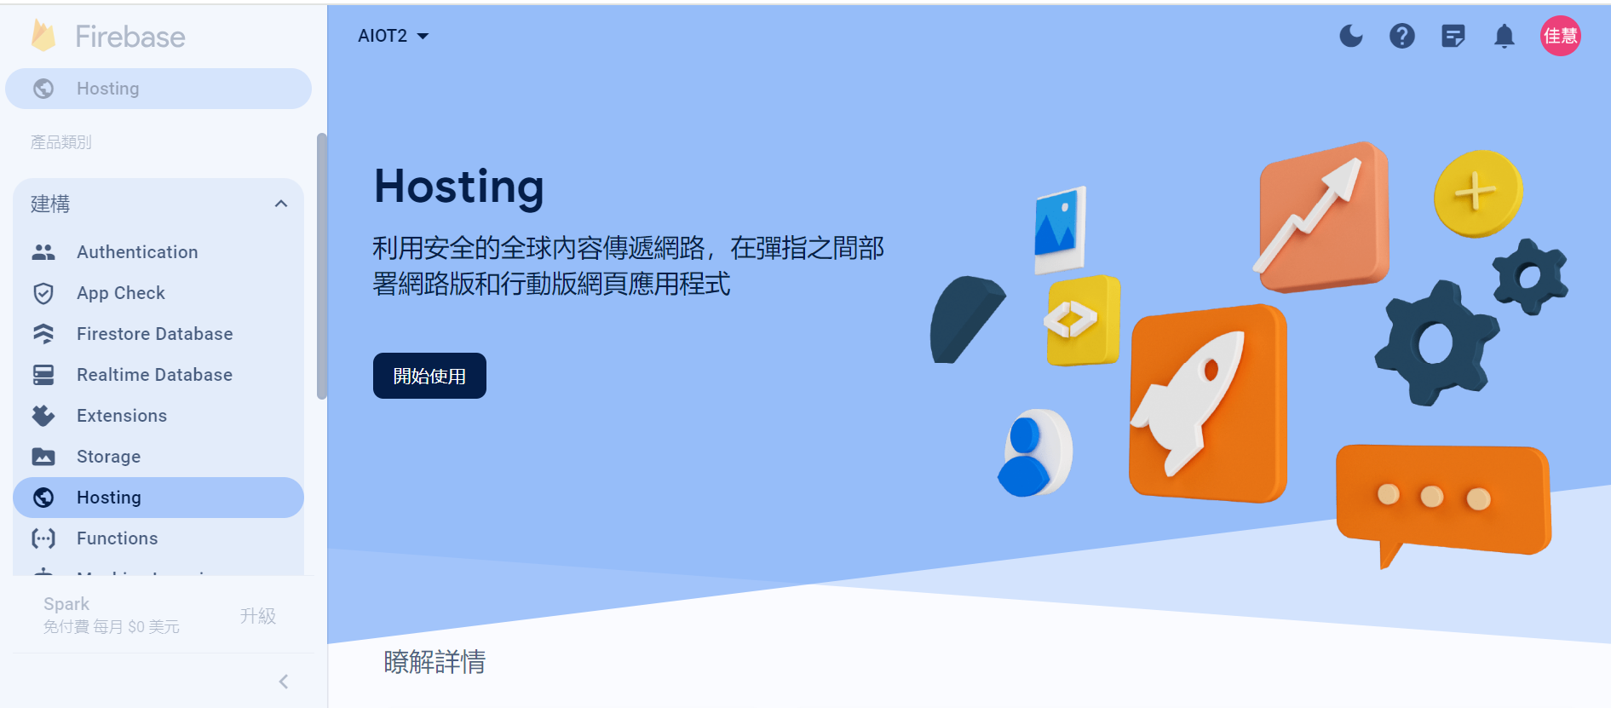

Slide 9
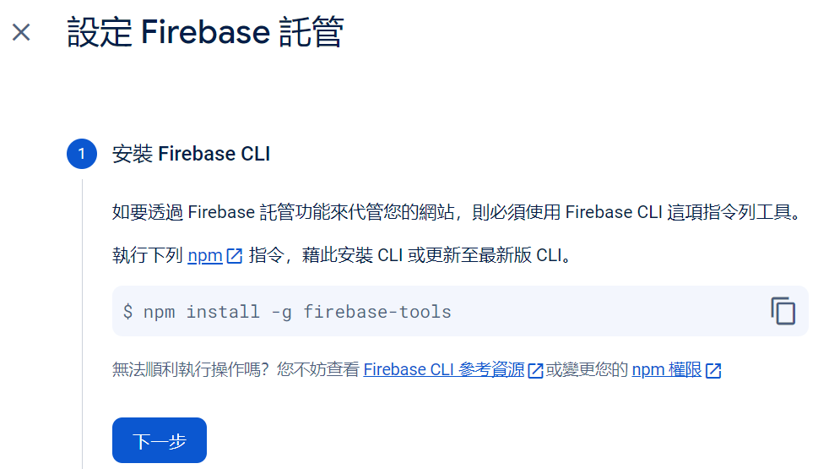
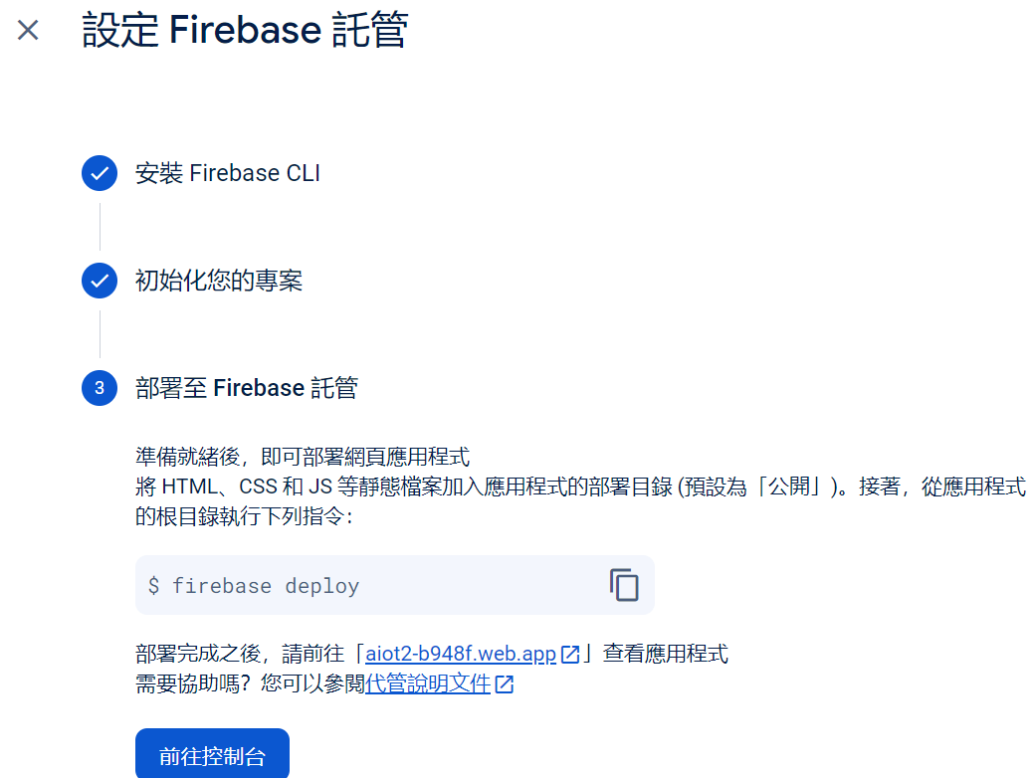

Slide 10
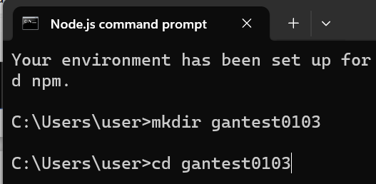
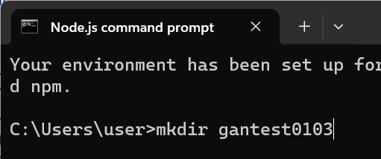
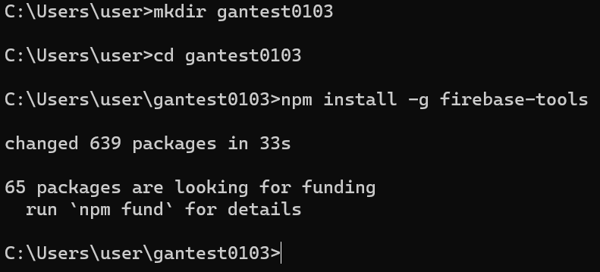
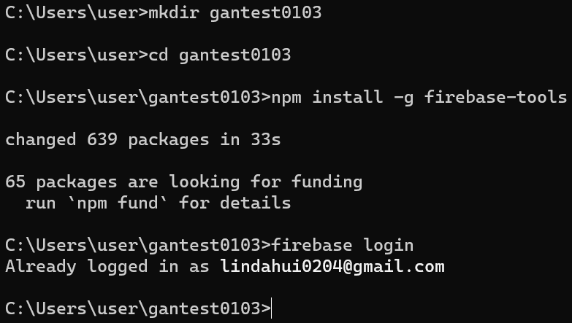

Slide 11
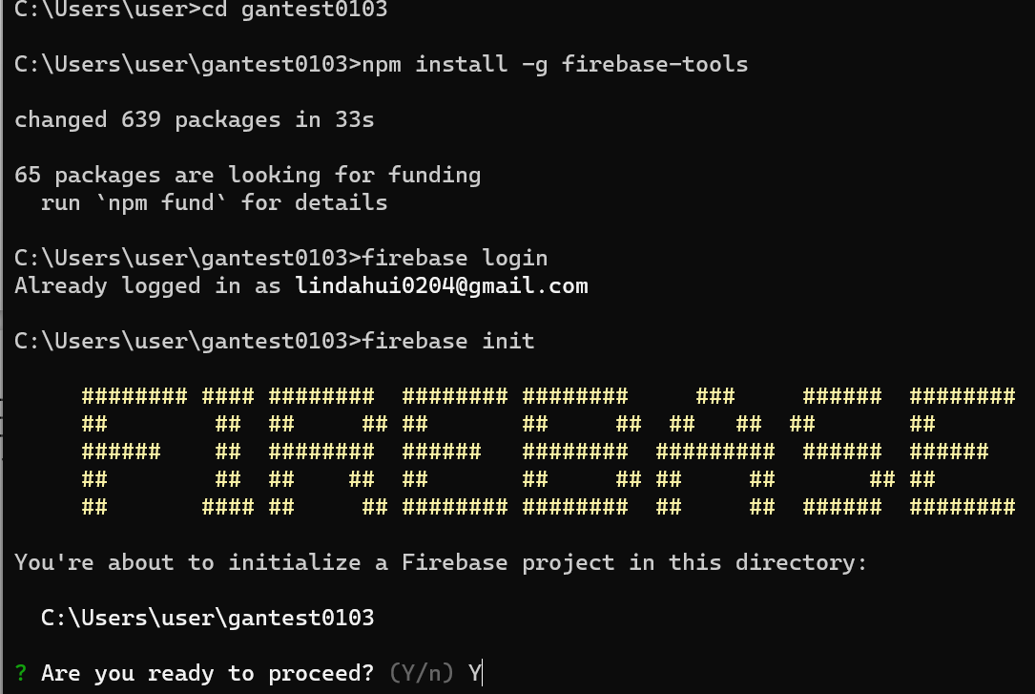
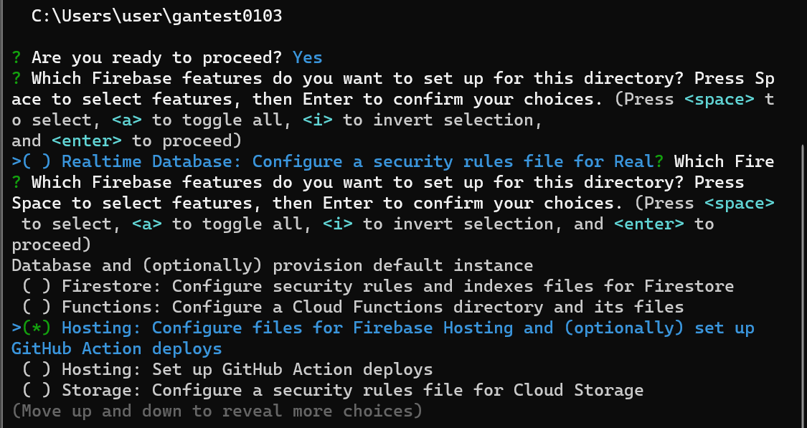

Slide 12
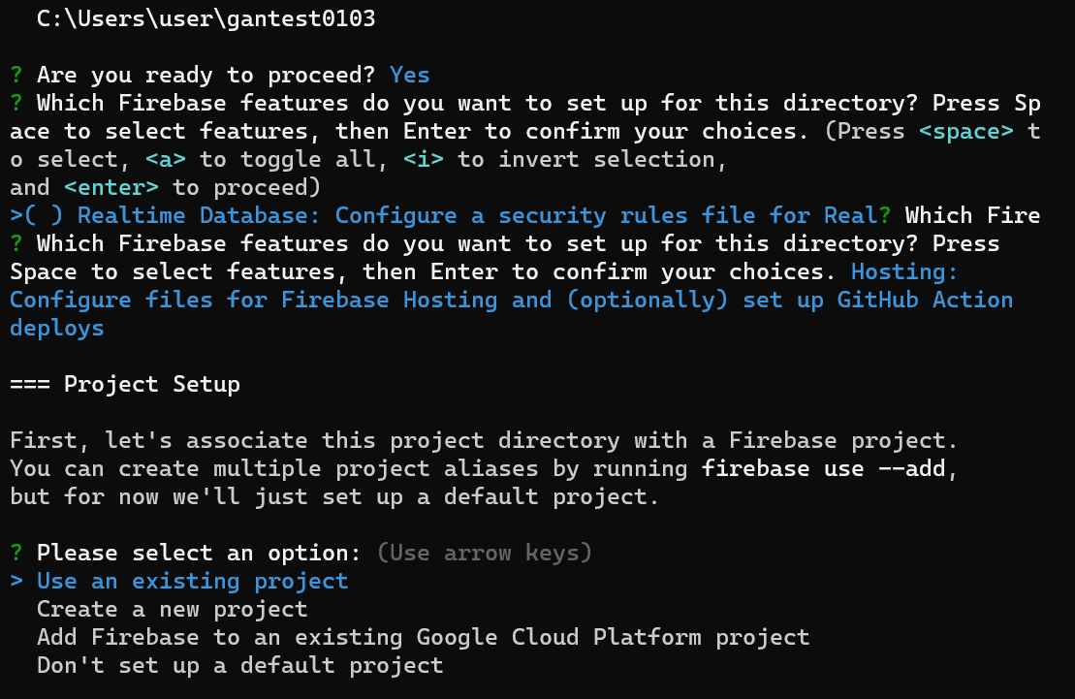
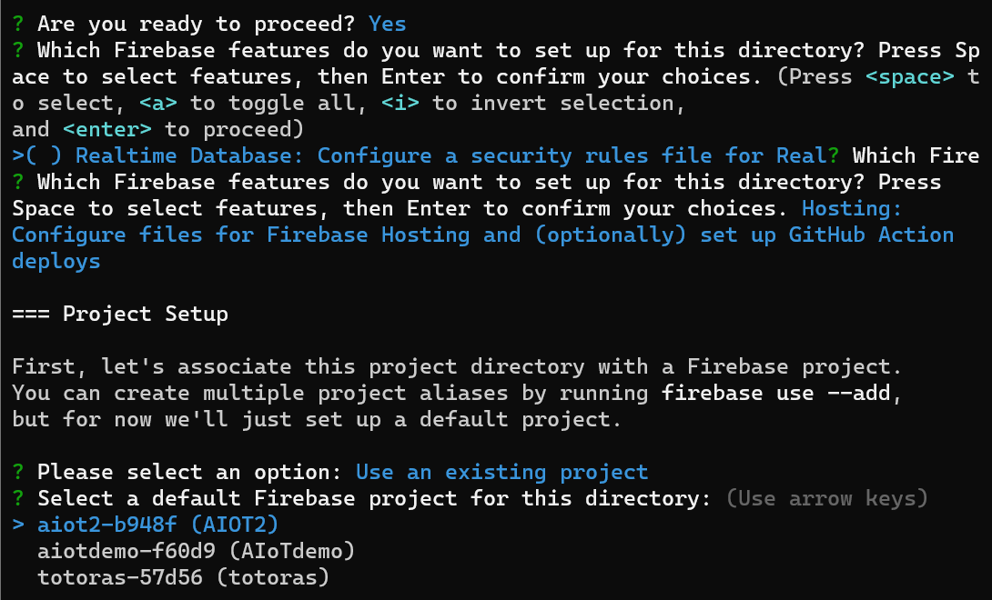

Slide 13
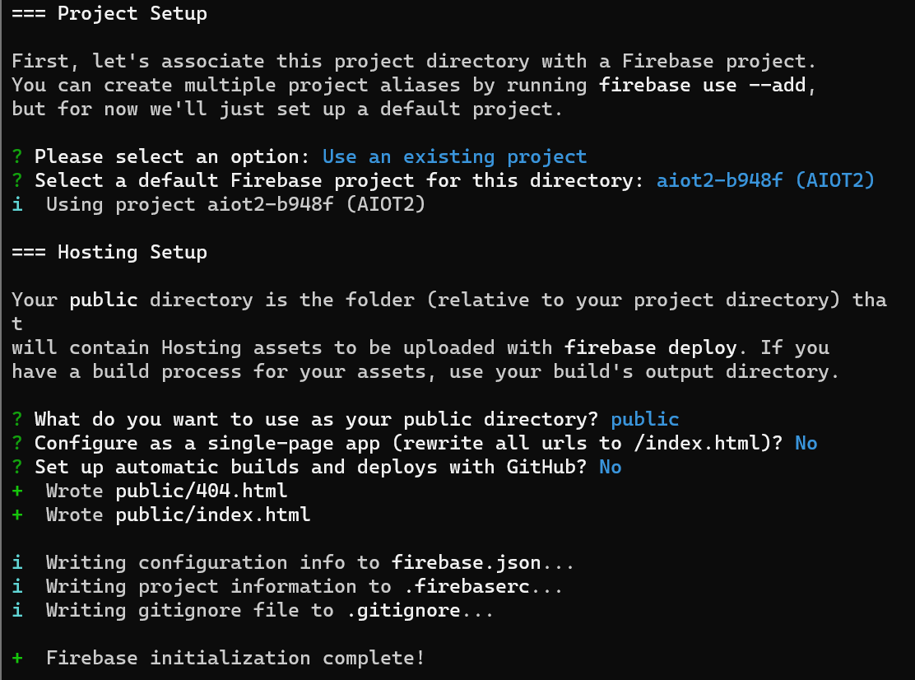
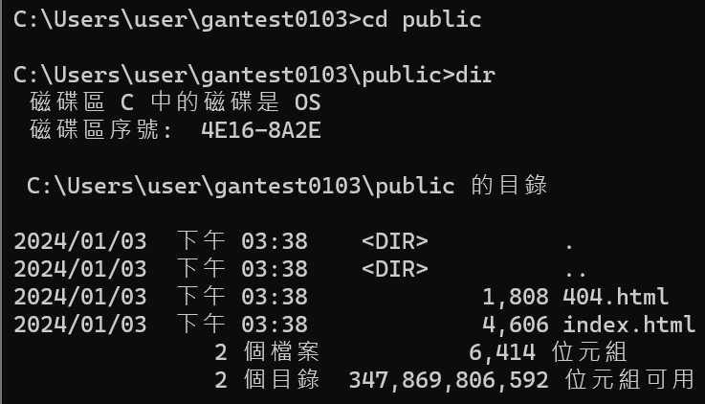

Slide 14
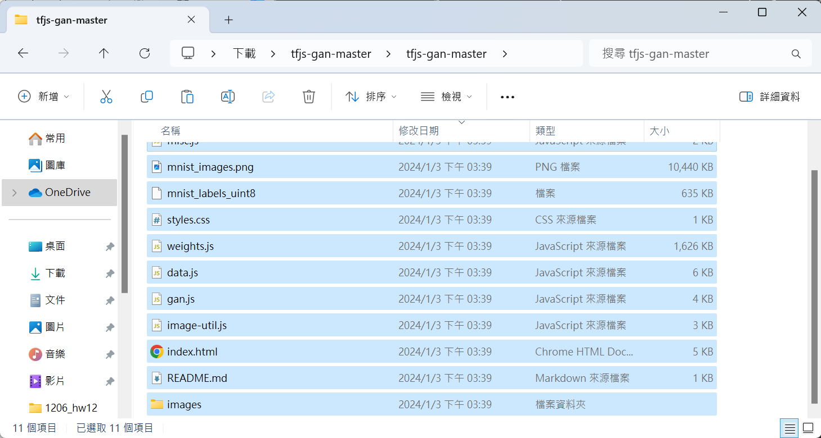

Slide 15
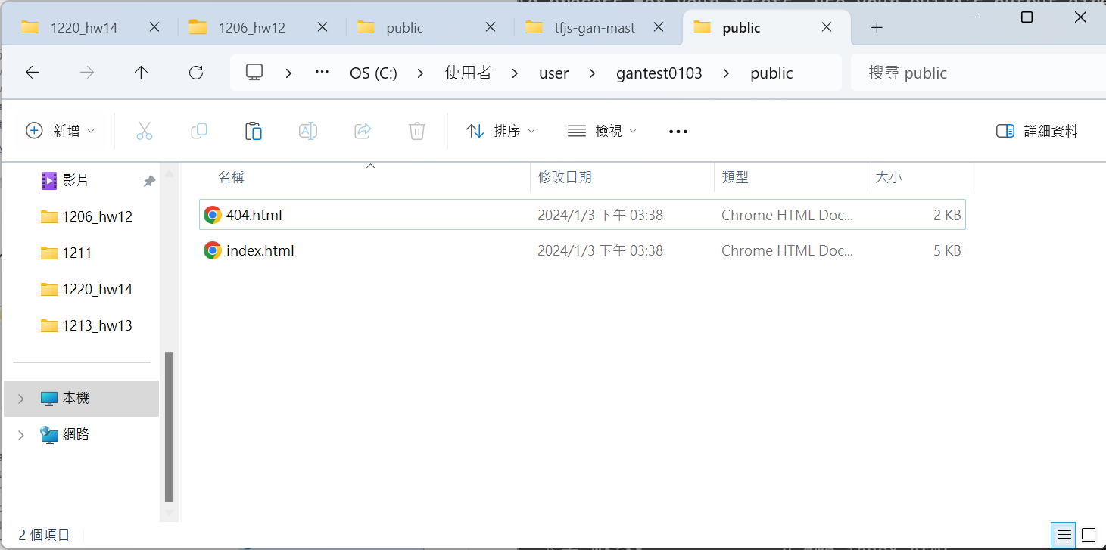

Slide 16
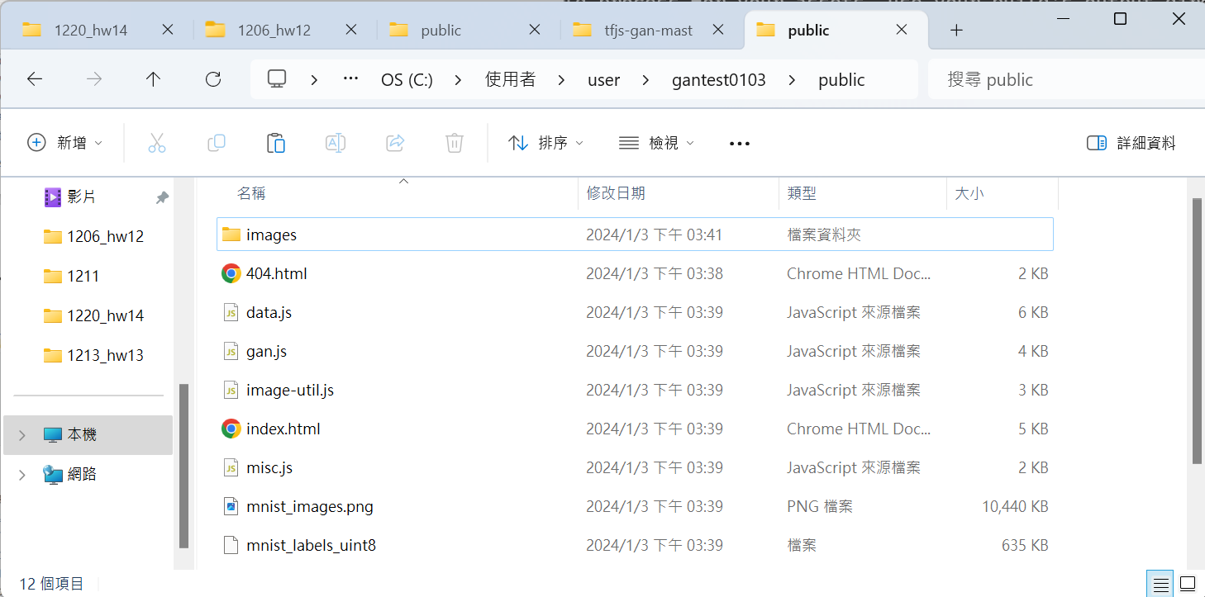

Slide 17
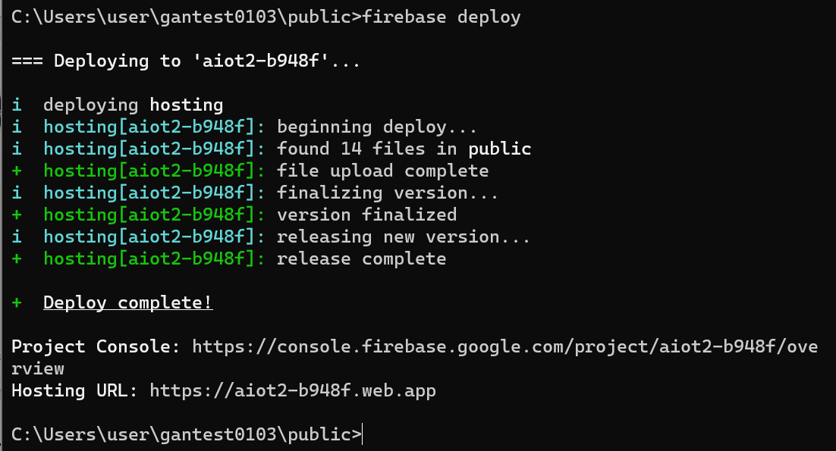

Slide 18
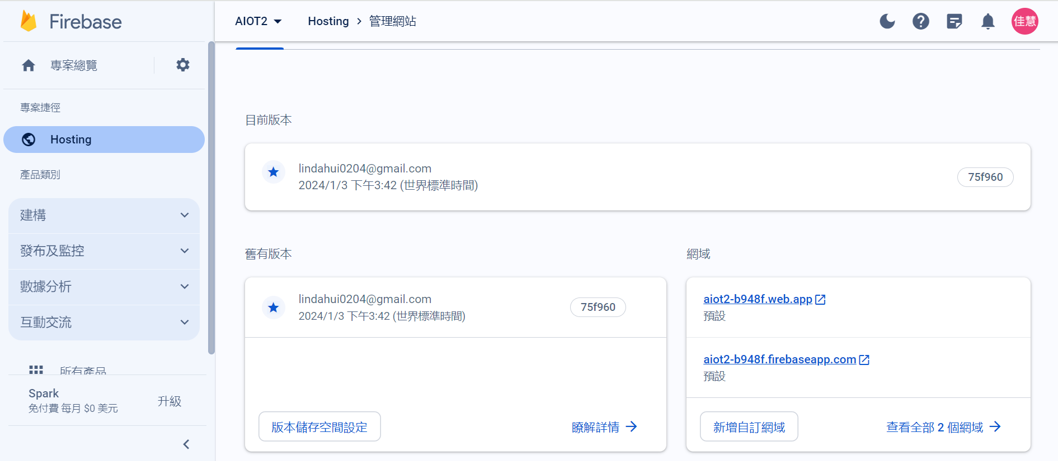

Slide 19
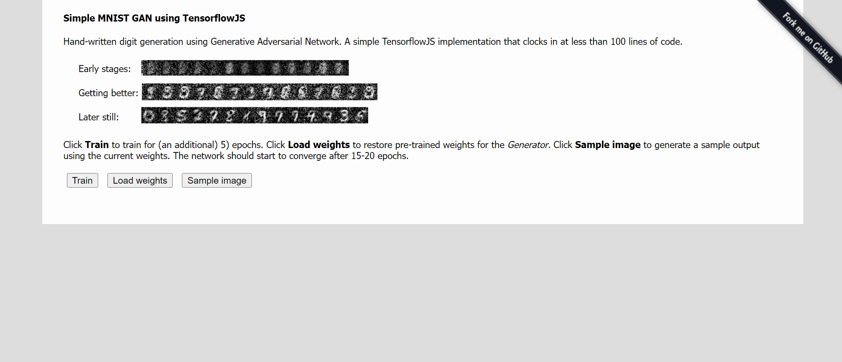

Slide 20
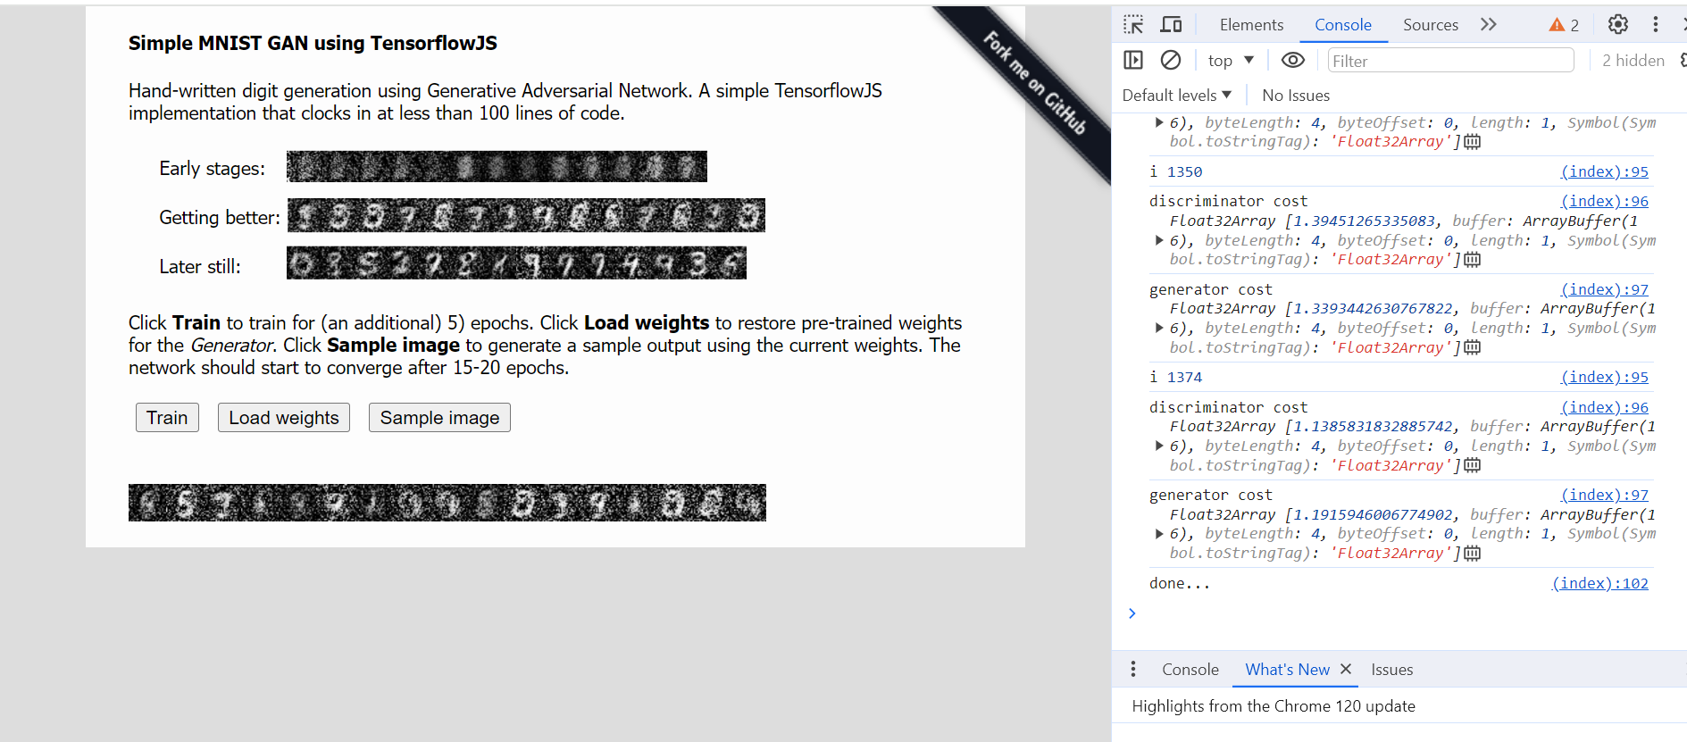

Slide 31
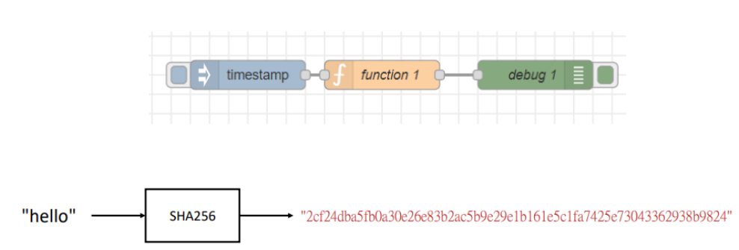
Exercise 14-1

Slide 32
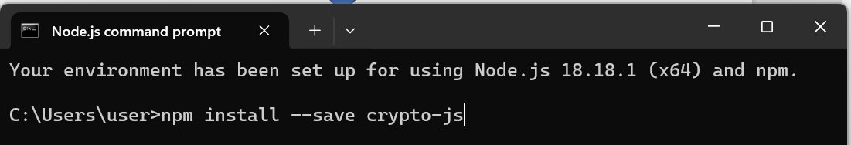
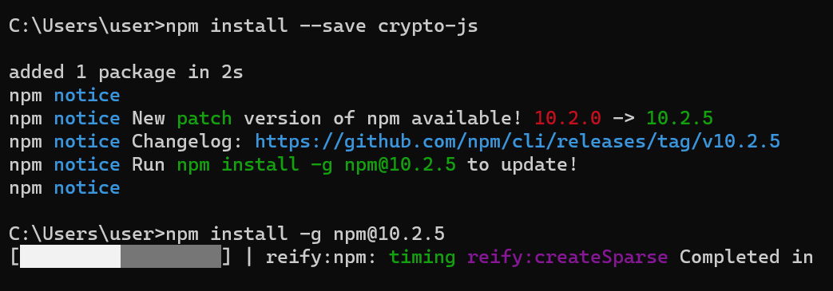
Install crypto-js
npm install –save crypto-js
Use “npm install –g npm@10.2.5 “ to update

Slide 33
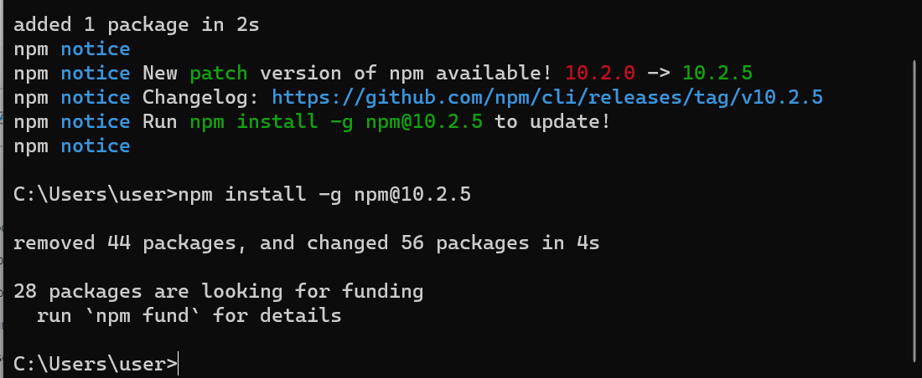
Done

Slide 34
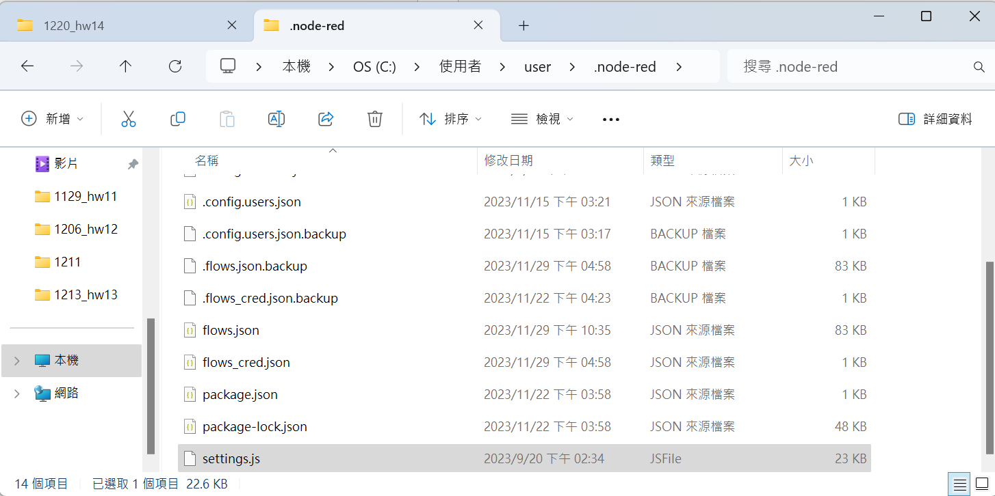
Edit settings.js

Slide 35
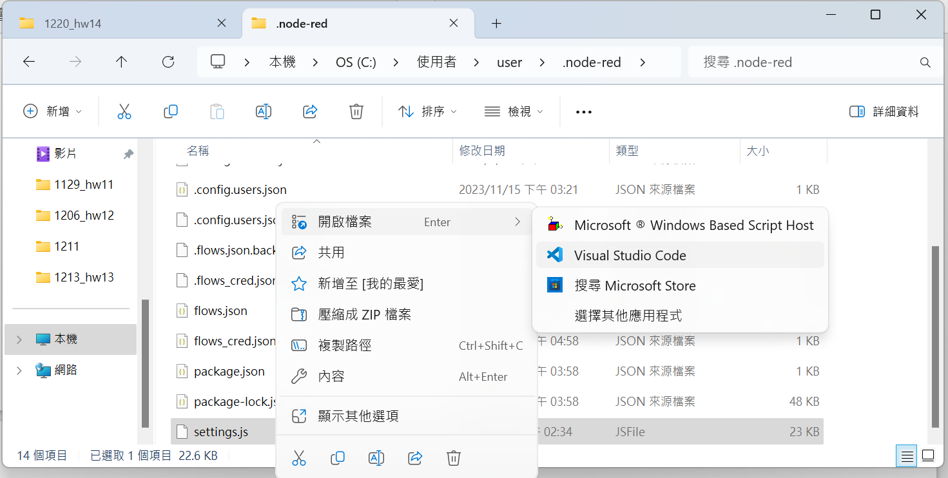
Edit settings.js
C:\Users\user\.node-red

Slide 36
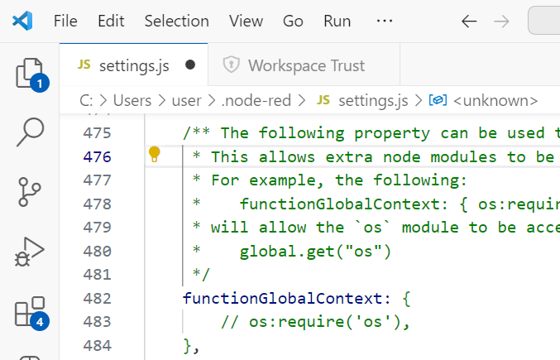
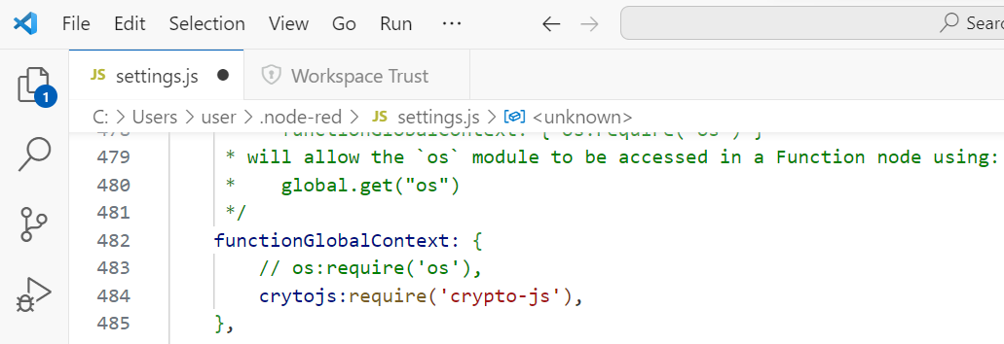
Edit settings.js
add
Save

Slide 37
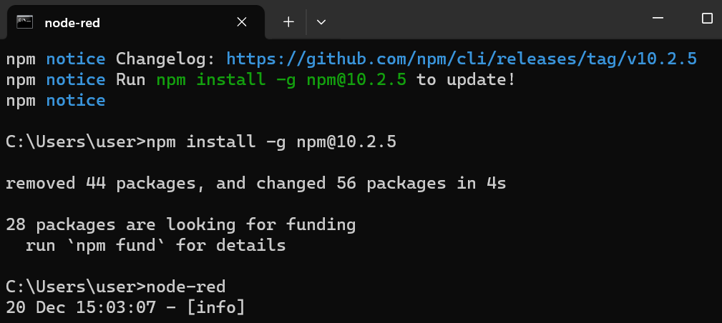
Run node-red

Slide 38
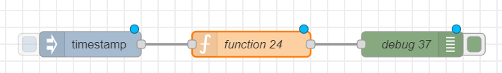
Build a Flow
var cryptojs = context.global.cryptojs;
var Hash = cryptojs.SHA256("hello");
msg.payload=Hash;
return msg;

Slide 39
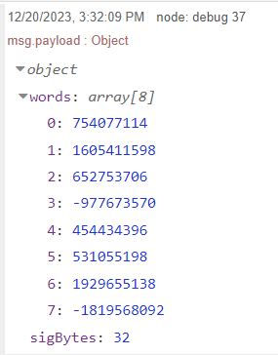
Trigger
click

Slide 40
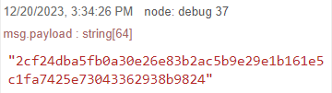
JavaScript Object toString()
click
var cryptojs = context.global.cryptojs;
var Hash = cryptojs.SHA256("hello");
msg.payload=Hash.toString();
return msg;

Slide 41
JavaScript Object toString()
Hash
Hash.toString();

Slide 42
Homework 15-1
• 比較傳統卷積運算與depthwise separable convolution參數量的比較。

Slide 43
var Hash = cryptojs.SHA1("hello");
var cryptojs = context.global.cryptojs;
var Hash = cryptojs.SHA1("hello");
msg.payload=Hash.toString();
return msg;

Slide 44
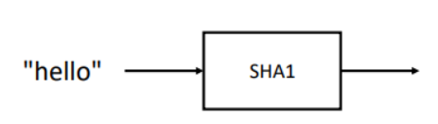
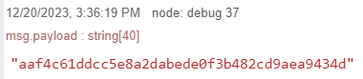

Slide 45
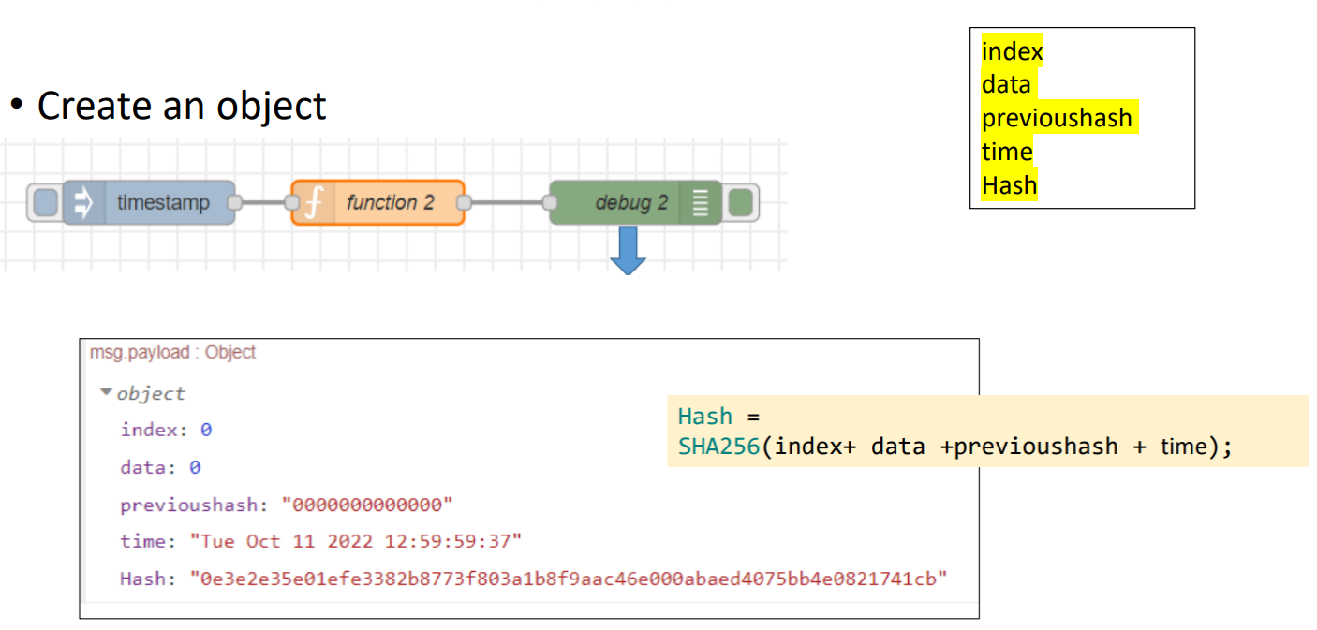
Exercise 14-2

Slide 46
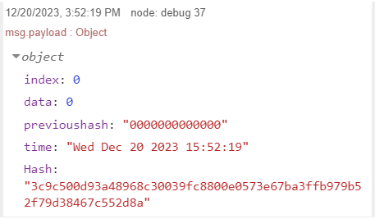
click
var cryptojs = context.global.cryptojs;
let data =0;
let previoushash="0000000000000";
const d = new Date();
var timestamp = d.getTime();
var time = d.toDateString()+" " + d.getHours()+":" + d.getMinutes()+":" + d.getSeconds();
var index = 0;
msg.url="";
var Hash = cryptojs.SHA256(previoushash + index + data + time);
msg.payload= {"index":index, "data":data, "previoushash":previoushash,"time":time, "Hash": Hash.toString()};
return msg;

Slide 47
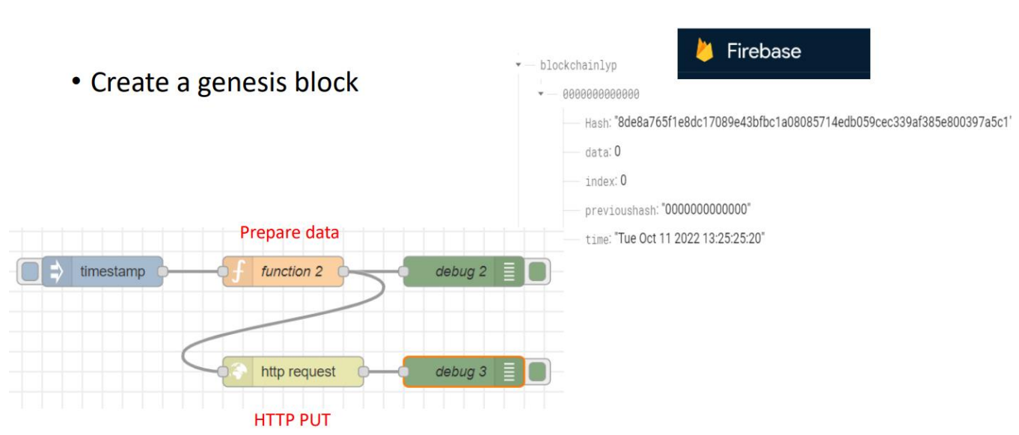
Exercise 14-3

Slide 48
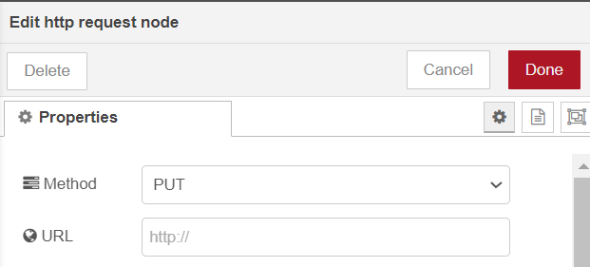
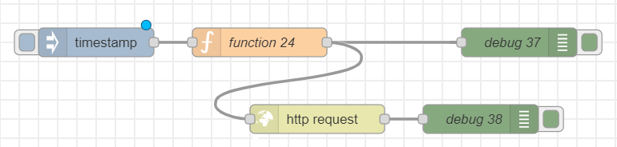
var cryptojs = context.global.cryptojs;
let data =0;
let previoushash="0000000000000";
const d = new Date();
var timestamp = d.getTime();
var time = d.toDateString()+" " + d.getHours()+":" + d.getMinutes()+":" + d.getSeconds();
var index = 0;
msg.url="https://xxxxxx-default-rtdb.firebaseio.com/" + "blockchainljh/" + "0000000000000" + ".json";
var Hash = cryptojs.SHA256(previoushash + index + data + time);
msg.payload= {"index":index, "data":data, "previoushash":previoushash,"time":time, "Hash": Hash.toString()};
return msg;

Slide 49



Check new data

Slide 50

Exercise 14-4

Slide 51


Set URL
HTTP GET
msg.url="https://aiotdemo-f60d9-default-rtdb.firebaseio.com/" + "blockchainljh.json";
return msg;

Slide 52
var revstr=msg.payload;
var obj=JSON.parse(revstr);
var revvalues=Object.values(obj);
var len = revvalues.length;
var lastvalue = revvalues[len - 1];
var previoushash = lastvalue.Hash;
var cryptojs = context.global.cryptojs;
let data = Math.round((Math.random()*100));
const d = new Date();
var timestamp = d.getTime();
var time = d.toDateString()+" " + d.getHours()+":" + d.getMinutes()+":" + d.getSeconds();
var index = len;
msg.url="https://xxxxxxx-default-rtdb.firebaseio.com/" + "blockchainljh/" + timestamp + ".json";
var Hash = cryptojs.SHA256(previoushash + index + data + time);
msg.payload= {"index":index, "data":data, "previoushash":previoushash,"time":time, "Hash": Hash.toString()};
return msg;

Slide 53

click

Slide 54

Exercise 14-5

Slide 55




HTTP PUT
Set URL
HTTP GET

Slide 56
click

Slide 57


New data

Slide 58

click

Slide 59


